Slide 1
COMP9024: Data Structures and Algorithms
Analysis of Algorithms

Slide 2
Contents
Big-oh notation
Big-theta notation
Big-omega notation
Asymptotic algorithm analysis

Slide 3
Analysis of Algorithms
Input
Algorithm
Output
An algorithm is a step-by-step procedure for solving a problem in a finite amount of time.

Slide 4
Running Time
Most algorithms transform input objects into output objects.
The running time of an algorithm typically grows with the input size.
Average case time is often difficult to determine.
We focus on the worst case running time.
Easier to analyze
Crucial to applications such as games, finance and robotics

Slide 5
Experimental Studies
Write a program implementing the algorithm
Run the program with inputs of varying size and composition
Use a method like System.currentTimeMillis() to get an accurate measure of the actual running time
Plot the results

Slide 6
Limitations of Experiments
It is necessary to implement the algorithm, which may be difficult
Results may not be indicative of the running time on other inputs not included in the experiment.
In order to compare two algorithms, the same hardware and software environments must be used

Slide 7
Theoretical Analysis
Uses a high-level description of the algorithm instead of an implementation
Characterizes running time as a function of the input size, n.
Takes into account all possible inputs
Allows us to evaluate the speed of an algorithm independent of the hardware/software environment

Slide 8
Pseudocode
Example: find max element of an array
High-level description of an algorithm
More structured than English prose
Less detailed than a program
Preferred notation for describing algorithms
Hides program design issues
Algorithm arrayMax(A, n)
{
Input array A of n integers
Output maximum element of A
currentMax = A[0]
for ( i=1; i<n; i++)
if A[i] > currentMax
currentMax =A[i]
return currentMax
}

Slide 9
C-Like Pseudocode Details
Control flow
if … [else …]
while …
do … while …
for …
Method declaration
Algorithm method (arg [, arg…])
Input …
Output …
Method call
var.method (arg [, arg…])
Return value
return expression
Expressions
= Assignment
= Equality testing
n² Superscripts and other mathematical formatting allowed

Slide 10
The Random Access Machine (RAM) Model
A CPU
An potentially unbounded bank of memory cells, each of which can hold an arbitrary number or character
2
1
0
Memory cells are numbered and accessing any cell in memory takes unit time.

Slide 11
Seven Important Functions
Seven functions that often appear in algorithm analysis:
Constant ≈ 1
Logarithmic ≈ log n
Linear ≈ n
N-Log-N ≈ n log n
Quadratic ≈ n²
Cubic ≈ n³
Exponential ≈ 2^{n}
In a log-log chart, the slope of the line corresponds to the growth rate of the function

Slide 12
Primitive Operations
Basic computations performed by an algorithm
Identifiable in pseudocode
Largely independent from the programming language
Exact definition not important (we will see why later)
Assumed to take a constant amount of time in the RAM model
Examples:
Evaluating an expression
Assigning a value to a variable
Indexing into an array
Calling a method
Returning from a method

Slide 13
Counting Primitive Operations
By inspecting the pseudocode, we can determine the maximum number of primitive operations executed by an algorithm, as a function of the input size
Algorithm arrayMax(A, n)
{
# operations
currentMax = A[0] 1
for (i =1; i<n-1; i++) n
if A[i] > currentMax n − 1
currentMax = A[i] n − 1
// increment counter i n − 1
return currentMax 1
} Total 4n − 1

Slide 14
Estimating Running Time
Algorithm arrayMax executes 4n − 1 primitive operations in the worst case. Define:
a = Time taken by the fastest primitive operation
b = Time taken by the slowest primitive operation
Let T(n) be worst-case time of arrayMax. Then a (4n − 1) ≤ T(n) ≤ b(4n − 1)
Hence, the running time T(n) is bounded by two linear functions

Slide 15
Growth Rate of Running Time
Changing the hardware/ software environment
Affects T(n) by a constant factor, but
Does not alter the growth rate of T(n)
The linear growth rate of the running time T(n) is an intrinsic property of algorithm arrayMax

Slide 16
Constant Factors
The growth rate is not affected by
constant factors or
lower-order terms
Examples
10²n + 10⁵ is a linear function
10⁵n² + 10⁸n is a quadratic function

Slide 17
Big-Oh Notation
Given functions f(n) and g(n), we say that f(n) is O(g(n)) if there are positive constants c and n₀ such that
f(n) ≤ cg(n) for n ≥ n₀
Example: 2n + 10 is O(n)
2n + 10 ≤ cn
(c − 2) n ≥ 10
n ≥ 10/(c − 2)
Pick c = 3 and n₀ = 10

Slide 18
Big-Oh Example
Example: the function n² is not O(n)
n² ≤ cn
n ≤ c
The above inequality cannot be satisfied since c must be a constant

Slide 19
More Big-Oh Examples
7n-2
7n-2 is O(n)
need c > 0 and n₀ ≥ 1 such that 7n-2 ≤ c•n for n ≥ n₀
this is true for c = 7 and n₀ = 1
3n³ + 20n² + 5
3n³ + 20n² + 5 is O(n³)
need c > 0 and n₀ ≥ 1 such that 3n³ + 20n² + 5 ≤ c•n³ for n ≥ n₀
this is true for c = 4 and n₀ = 21
3 log n + 5
3 log n + 5 is O(log n)
need c > 0 and n₀ ≥ 1 such that 3 log n + 5 ≤ c•log n for n ≥ n₀
this is true for c = 8 and n₀ = 2

Slide 20
Big-Oh and Growth Rate
The big-Oh notation gives an upper bound on the growth rate of a function
The statement “f(n) is O(g(n))” means that the growth rate of f(n) is no more than the growth rate of g(n)
We can use the big-Oh notation to rank functions according to their growth rate
 | f(n) is O(g(n)) | g(n) is O(f(n))
g(n) grows more | Yes | No
f(n) grows more | No | Yes
Same growth | Yes | Yes

Slide 21
Big-Oh Rules (1/3)
If is f(n) a polynomial of degree d, then f(n) is O(n^{d}), i.e.,
Drop lower-order terms
Drop constant factors
Use the smallest possible class of functions
Say “2n is O(n)” instead of “2n is O(n²)”
Use the simplest expression of the class
Say “3n + 5 is O(n)” instead of “3n + 5 is O(3n)”

Slide 22
Big-Oh Rules (2/3)
5n⁵+20n⁴-3n³log²n+10⁷n is O(n⁵)
Step 1: Drop lower-order terms: 5n⁵
Step 2: Drop constant factors: n⁵
Therefore, 5n⁵+20n⁴-3n³log²n+10⁷n is O(n⁵).
10n⁵+200n⁴logn-3n³log²n+5000n
Step 1: Drop lower-order terms: 10n⁵
Step 2: Drop constant factors: n⁵
Therefore, 10n⁵+200n⁴logn-3n³log²n+5000n is O(n⁵).
10*2^{n}+200n⁴⁰⁰-3n³log²n+500n
Step 1: Drop lower-order terms: 10*2^{n}
Step 2: Drop constant factors: 2^{n}
10*2^{n}+200n⁴⁰⁰-3n³log²n+500n is O(2^{n}).

Slide 23
Big-Oh Rules (3/3)
1+2³+ 3³ +… + n³
Step 1: Drop lower-order terms: n³
Step 2: Drop constant factors: n³
Therefore, 1+2³+ 3³ +… + n³ is O(n³) 
The drop-constant-factor rule is only applicable to an arithmetic expression with a constant number of terms.
1+2³+ 3³ +… + n³ < n*n³=O(n⁴)

Slide 24
Asymptotic Algorithm Analysis
The asymptotic analysis of an algorithm determines the running time in big-Oh notation.
To perform the asymptotic analysis
We find the worst-case number of primitive operations executed as a function of the input size
We express this function with big-Oh notation
Example:
We determine that algorithm arrayMax executes at most 4n − 1 primitive operations
We say that algorithm arrayMax “runs in O(n) time”
Since constant factors and lower-order terms are eventually dropped anyhow, we can disregard them when counting primitive operations

Slide 25
Computing Prefix Averages
We further illustrate asymptotic analysis with two algorithms for prefix averages
The i-th prefix average of an array X is average of the first (i + 1) elements of X:
A[i] = (X[0] + X[1] + … + X[i])/(i+1)
Computing the array A of prefix averages of another array X has applications to financial analysis

Slide 26
Prefix Averages (Quadratic)
The following algorithm computes prefix averages in quadratic time by applying the definition
Algorithm prefixAverages1(X, n)
{
Input array X of n integers
Output array A of prefix averages of X #operations
A = new array of n integers; n
for ( i = 0; i < n; i++) n+1
{ s = X[0]; n
for ( j =1; j ≤ i ; j++) 1 + 2 + …+ (n − 1)+n
s = s + X[j]; 1 + 2 + …+ (n − 1)
A[i] = s / (i + 1); n
}
return A; 1
}

Slide 27
Arithmetic Progression
The total number of primitive operations of prefixAverages1 is
n+n+1+n+1 + 2 + …+ (n − 1)+n+1 + 2 + …+ (n −1)+n+1
=n²+4n+2=O(n²).
Thus, algorithm prefixAverages1 runs in O(n²) time, or we say the time complexity of prefixAverages1 is O(n²).

Slide 28
Prefix Averages (Linear)
The following algorithm computes prefix averages in linear time by keeping a running sum
Algorithm prefixAverages2(X, n)
{ Input array X of n integers
Output array A of prefix averages of X #operations
A = new array of n integers n
s = 0 1
for ( i = 0; i < n; i++ ) n
{ s = s + X[i] n
A[i] = s / (i + 1) n
}
return A 1
}
Algorithm prefixAverages2 runs in O(n) time

Slide 29
Binary Search (1/4)
The following recursive algorithm searches for a value in a sorted array:
BinarySearch(v, a, lo, hi)
Input value v
array a[lo..hi] of values
Output true if v in a[lo..hi]
false otherwise
mid=(lo+hi)/2
if lo>hi return false
if a[mid]=v return true
else if a[mid]<v
return BiarySearch(v,a,mid+1,hi)
else
return BinarySearch(v,a,lo,mid-1)

Slide 30
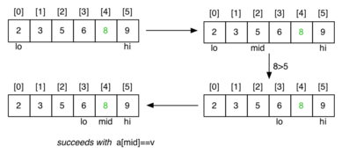
Binary Search (2/4)
Successful search for a value of 8:

Slide 31
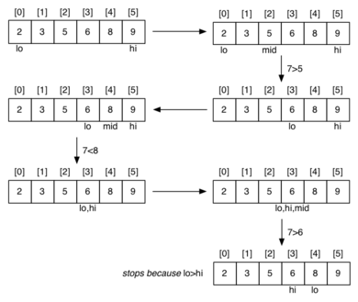
Binary Search (3/4)
Unsuccessful search for a value of 7:

Slide 32
Binary Search (4/4)
Time complexity analysis:
A single call of BinarySearch() takes O(1) time
The number of calls of BinarySearch() is O(log n) in the worst case
Therefore, the time complexity of the binary search is O(log n)

Slide 33
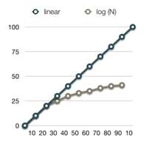
Linear Time vs Logarithmic Time
A logarithmic time algorithm is much faster than a linear time one

Slide 34
Computing Powers (1/3)
The power function, p(x,n)=x^{n}, can be defined recursively:
This leads to an power function that runs in O(n) time (for we make n recursive calls).
We can do better than this, however.

Slide 35
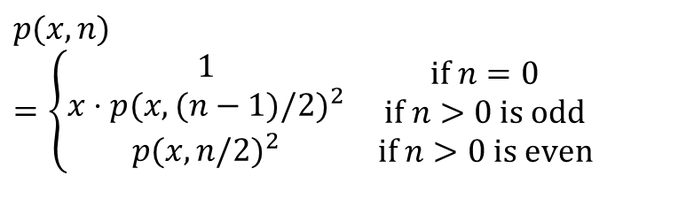
Computing Powers (2/3)
We can derive a more efficient linearly recursive algorithm by using repeated squaring:
For example,
2⁴ = 2^{(4/2)2} = (2^{4/2})² = (2²)² = 4² = 16
2⁵ = 2^{1+(4/2)2} = 2(2^{4/2})² = 2(2²)² = 2(4²) = 32
2⁶ = 2^{(6/ 2)2} = (2^{6/2})² = (2³)² = 8² = 64
2⁷ = 2^{1+(6/2)2} = 2(2^{6/2})² = 2(2³)² = 2(8²) = 128.
$$p(x,n)=\left\{\begin{matrix}\begin{matrix}1 \\ x⋅p(x,(n−1)/2)^{2} \\ p(x,n/2)^{2}\end{matrix} & \begin{matrix}\text{if} n=0 \\ \text{if} n>0 \text{is} \text{odd} \\ \text{if} n>0 \text{is} \text{even}\end{matrix}\end{matrix}\right.$$

Slide 36
Computing Powers (3/3)
Algorithm Power(x, n)
{
Input : A number x and integer n = 0
Output : The value x^{n}
if n = 0 return 1
if n is odd
{ y = Power(x, (n - 1)/ 2)
return x*y*y }
else
{ y = Power(x, n/ 2)
return y*y }
}
Time complexity analysis:
Each call of Power() takes O(1) time
There are O(log n) calls
Time complexity: O(log n)

Slide 37
Computing Fibanacci Numbers (1/3)
Fibonacci numbers are defined recursively:
F₀ = 0
F₁ = 1
F_{i} = F_{i-1} ⁺ F_{i-2} for i > 1.
As a recursive algorithm (first attempt):
Algorithm BinaryFib(k)
{ Input : Nonnegative integer k
Output : The kth Fibonacci number F_{k}
if ( k =0 or 1) return k;
else
return BinaryFib(k - 1) + BinaryFib(k - 2);
}

Slide 38
Computing Fibanacci Numbers (2/3)
Let n_{k} denote number of recursive calls made by BinaryFib(k). Then
n₀ = 1
n₁ = 1
n₂ = n₁ + n₀ + 1 = 1 + 1 + 1 = 3
n₃ = n₂ + n₁ + 1 = 3 + 1 + 1 = 5
n₄ = n₃ + n₂ + 1 = 5 + 3 + 1 = 9
n₅ = n₄ + n₃ + 1 = 9 + 5 + 1 = 15
n₆ = n₅ + n₄ + 1 = 15 + 9 + 1 = 25
n₇ = n₆ + n₅ + 1 = 25 + 15 + 1 = 41
n₈ = n₇ + n₆ + 1 = 41 + 25 + 1 = 67.
Note that the value at least doubles for every other value of n_{k}. That is, n_{k} > 2^{k/2}. It is exponential!
Time complexity: O(2^{k})

Slide 39
Computing Fibanacci Numbers (3/3)
To compute F_{k}’s only once, we remember the value of each F_{k}:
Algorithm LinearFibonacci(k):
{ Input : A nonnegative integer k
Output : Pair of Fibonacci numbers (F_{k}, F_{k-1})
if ( k = 1) return (k, 0);
else
{
(i, j) = LinearFibonacci(k - 1);
return (i +j, i);
}
}
Time complexity: O(k)

Slide 40
* Space Complexity Analysis for Recursive Algorithms (1/9)
In general, space complexity analysis is easier than time complexity analysis.
The hard part in analyzing the space complexity of a recursive algorithm is in the stack space complexity.
We need to understand how a recursive method is executed on computers.
Key concept: stack frame or activation record.

Slide 41
* Space Complexity Analysis for Recursive Algorithms (2/9)
A stack frame for a function stores the local variables, some parameters, the return address, and some other stuff such as values of some registers.
A stack frame is created in the stack space whenever a function is called.
A stack frame is freed when the function returns.
The fame size of each frame can be determined at compile time.

Slide 42
* Space Complexity Analysis for Recursive Algorithms (3/9)
A call graph is a weighted directed graph G = (V, E, W) where
V={v₁, v₂, …, v_{n}} is a set of nodes each of which denotes an execution of a function;
E={v_{i}→v_{j}: v_{i} calls v_{j}} is a set of directed edges each of which denotes the caller-callee relationship, and
W={w_{i} (i=1, 2, …, n): w_{i} is the frame size of v_{i}} is a set of stack frame sizes.
The maximum size of stack space needed for method calls can be derived from the call graph.

Slide 43
* Space Complexity Analysis for Recursive Algorithms (4/9)
How to compute the maximum size of stack space needed for a method call?
Step 1: Draw the call graph.
Step 2: Find the longest weighted path in the call graph.
The total weight of the longest weighted path is the maximum stack size needed for the function calls.

Slide 44
* Space Complexity Analysis for Recursive Algorithms (5/9)
int main(void)
{ …
func1();
…
func2();
}
void func1()
{ …
func3();
…
}
void func2()
{ …
func4();
…
func5();
…
}
int func3()
{ …
x=func3();
…
}
Assumptions:
func3() is called 20 times
Frame sizes (bytes):
main(): 10
func1(): 20
func2(): 60
func3(): 80
func4(): 10
func5(): 30

Slide 45
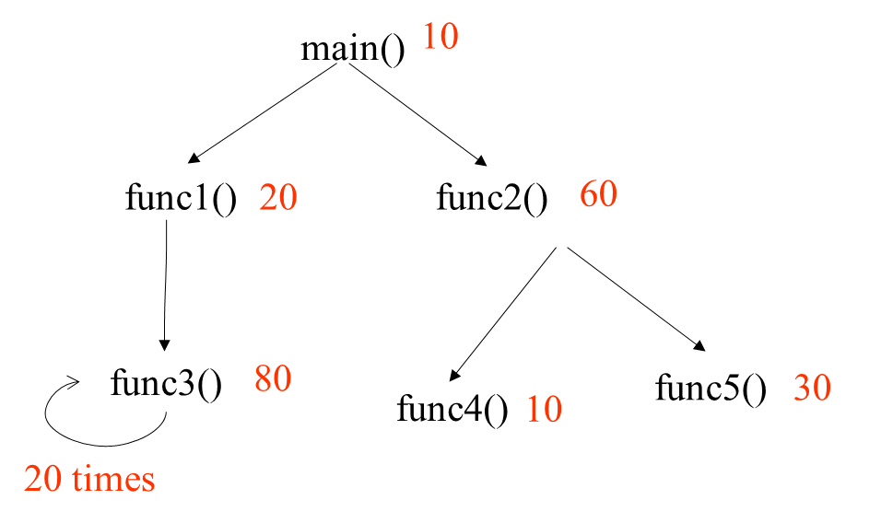
* Space Complexity Analysis for Recursive Algorithms (6/9)
The longest path is main() func1() func3() … func3() with a length (total weight) of 10+20+80*20=1630. So the maximum stack space needed for main() is 1630 bytes.

Slide 46
* Space Complexity Analysis for Recursive Algorithms (7/9)
The above approach can be generalized to recursive algorithms.
The frame size of each algorithm is represented by big O.
Compute the longest path length in terms of big O.
Consider the previous example.
Assume that the frame sizes of all the methods except func4() are O(1), and the frame size of func4() is O(n). The space complexity of main() is O(n).
Assume that the frame sizes of all the methods are O(1). The space complexity of main() is O(1).

Slide 47
* Space Complexity Analysis for Recursive Algorithms (8/9)
Recursive algorithm for Fibonacci numbers:
Algorithm Fib(k)
{ Input : Nonnegative integer k
Output : The kth Fibonacci number F_{k}
if ( k =0 or 1) return k;
else
return Fib(k - 1) + Fib(k - 2);
}
What is the space complexity of Fib(n) in terms of big-O?

Slide 48
* Space Complexity Analysis for Recursive Algorithms (9/9)
What is the space complexity of BinaryFib(n) in terms of big-O?
Fib(n)
Fib(n-1)
Fib(n-2)
Fib(n-2)
The space complexity: the number of node on the longest path * frame size=n*c=O(n)
Fib(n-3)
…
Subtree for
Fib(n-3)
Subtree for
Fib(n-4)
Subtree for
Fib(n-3)
Fib(1)
Subtree for
Fib(n-4)
Subtree for
Fib(n-5)

Slide 49
Math you need to Review
Summations
Logarithms and Exponents
Proof techniques
Basic probability
properties of logarithms:
log_{b}(xy) = log_{b}x + log_{b}y
log_{b} (x/y) = log_{b}x - log_{b}y
log_{b}xª = alog_{b}x
log_{b}a = log_{x}a/log_{x}b
properties of exponentials:
a^{(b+c)} = a^{b}a^{c}
a^{bc} = (a^{b})^{c}
a^{b}/a^{c} = a^{(b-c)}
b = a ^{log}_{a}^{b}
b^{c} = a ^{c*log}_{a}^{b}

Slide 50
Relatives of Big-Oh
Big-Omega
f(n) is Ω(g(n)) if there is a constant c > 0
and an integer constant n₀ ≥ 1 such that
f(n) ≥ c•g(n) for n ≥ n₀
Big-Theta
f(n) is Θ(g(n)) if there are constants c’ > 0 and c’’ > 0 and an integer constant n₀ ≥ 1 such that c’•g(n) ≤ f(n) ≤ c’’•g(n) for n ≥ n₀

Slide 51
Intuition for Asymptotic Notation
Big-Oh
f(n) is O(g(n)) if f(n) is asymptotically less than or equal to g(n)
Big-Omega
f(n) is Ω(g(n)) if f(n) is asymptotically greater than or equal to g(n)
Big-Theta
f(n) is Θ(g(n)) if f(n) is asymptotically equal to g(n)

Slide 52
Example Uses of the Relatives of Big-Oh
5n² is Ω(n²)
f(n) is Ω(g(n)) if there is a constant c > 0 and an integer constant n₀ ≥ 1 such that f(n) ≥ c•g(n) for n ≥ n₀
let c = 5 and n₀ = 1
5n² is Ω(n)
f(n) is Ω(g(n)) if there is a constant c > 0 and an integer constant n₀ ≥ 1 such that f(n) ≥ c•g(n) for n ≥ n₀
let c = 1 and n₀ = 1
5n² is Θ(n²)
f(n) is Θ(g(n)) if it is Ω(n²) and O(n²). We have already seen the former, for the latter recall that f(n) is O(g(n)) if there is a constant c > 0 and an integer constant n₀ ≥ 1 such that f(n) < c•g(n) for n ≥ n₀
Let c = 5 and n₀ = 1

Slide 53
Summary
Big-Oh, big-theta and big-omega notations
Asymptotic analysis of algorithms
Examples of algorithms with logarithmic, linear, polynomial, exponential time complexity
Suggested reading:
Sedgewick, Ch.2.1-2.4,2.6

